Slide 1

Guide to Prevocational Training for Supervisors

Slide 2

Acknowledgement to Country
We acknowledge this land that we work on today is the traditional lands for the Kaurna people and that we respect their spiritual relationship with their country. We also acknowledge the Kaurna people as the custodians of the greater Adelaide region and that their cultural and heritage beliefs are still important to the living Kaurna people today. We also pay respects to the traditional lands others are joining from today.

Slide 3

What is prevocational training?
Australian medical graduates receive provisional registration from the Medical Board of Australia (MBA)
They must complete a year of work-based generalist training in an accredited PGY1 program to obtain general registration
A small number begin specialists training in their PGY2, however as part of the Framework most will complete another year of generalist training
These two years make up prevocational training
This will be supported by a new National Framework for Prevocational (PGY1 &PGY2) Medical Training to commence in 2024 for PGY1 doctors and 2025 for PGY2 doctors
Notes:
Australian medical graduates receive provisional registration from the Medical Board of Australia and must complete a year of work-based generalist training in an accredited PGY1 program before general registration.
A small minority begin specialty training in PGY2, however as part of the Framework most go on to complete a second year of generalist training.
These two years make up prevocational training and are supported by a new National Framework for Prevocational Medical Training, to be implemented in 2024 for PGY1 and 2025 for PGY2.

Slide 4
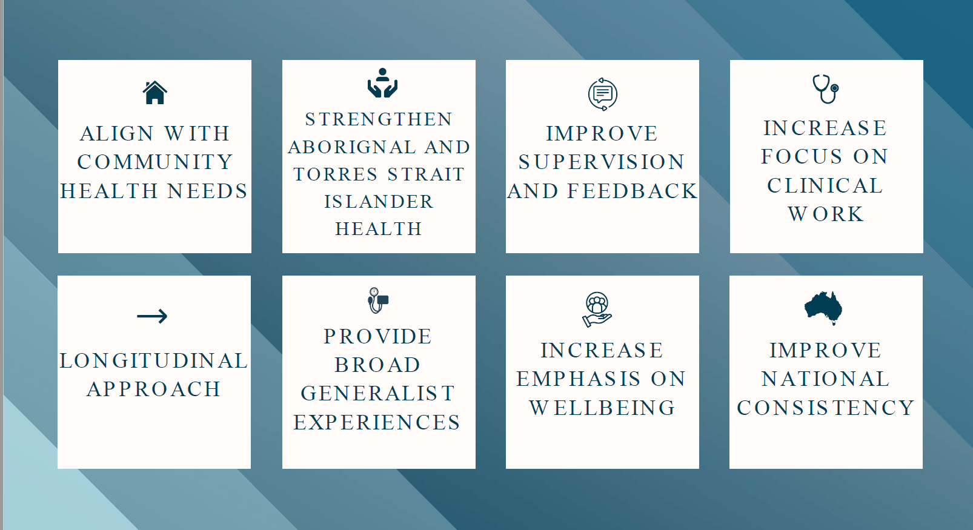
The goals of the AMC National Framework
Notes:
The goals of the framework are:
Align with community health needs
Longitudinal approach
Strengthen Aboriginal and Torres Strait Islander health
Provide broad generalist experiences
Improve supervision and feedback
Increase emphasis on wellbeing
Increase focus on clinical work
Improve national consistency

Slide 5
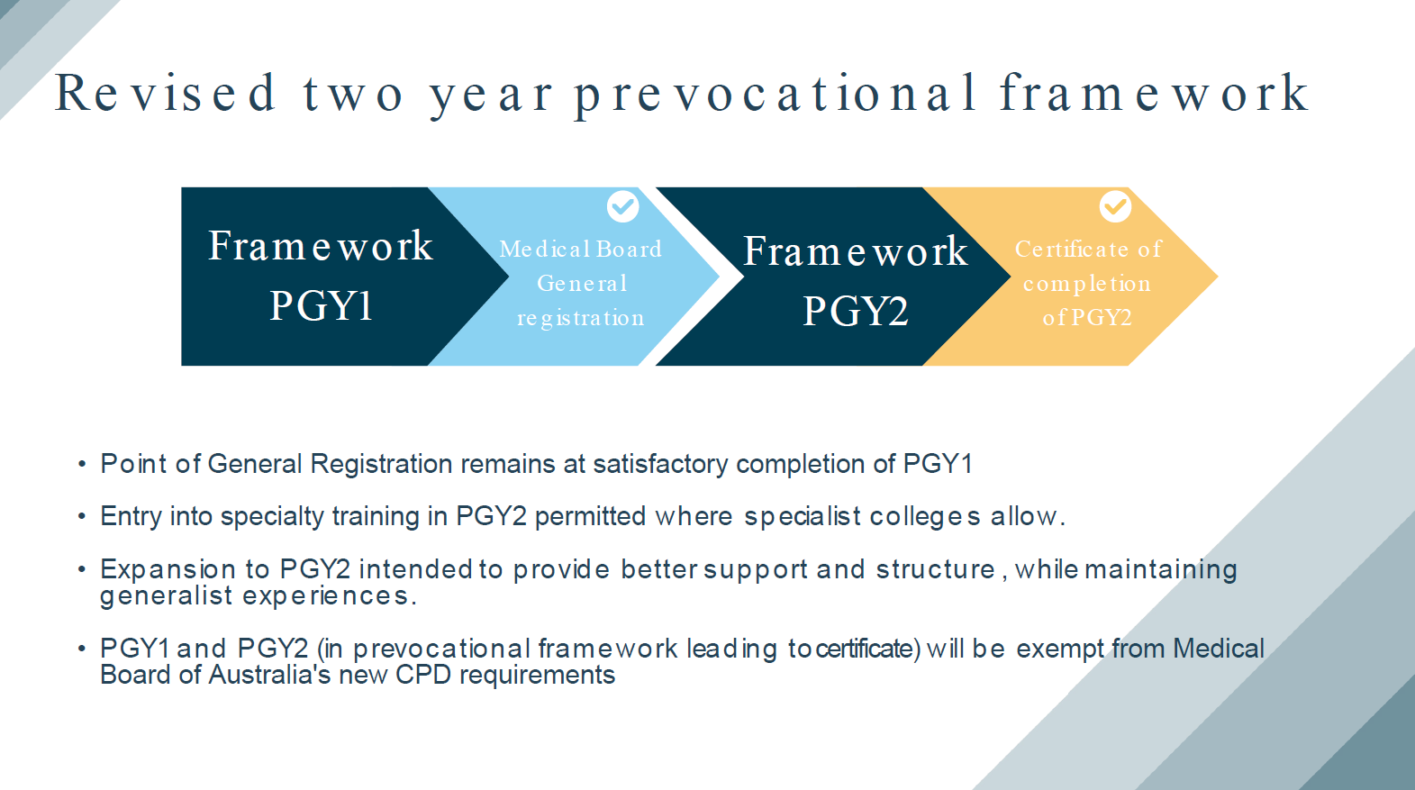
Overview of AMC National Framework
Notes:
This provides an overview of the Framework over the two years.
It is important to understand this is not a two year internship, PGY1 doctors will still receive general registration after successful completion of the PGY1 year.
Entry into a specialist training program is still permitted during PGY2 where the college allows.
The expansion to PGY2 is intended to provide better support and structure.
Doctors completing an accredited PGY1 or PGY2 program are exempt from the Medical Board of Australia’s continuing professional development (CPD) requirements.

Slide 6
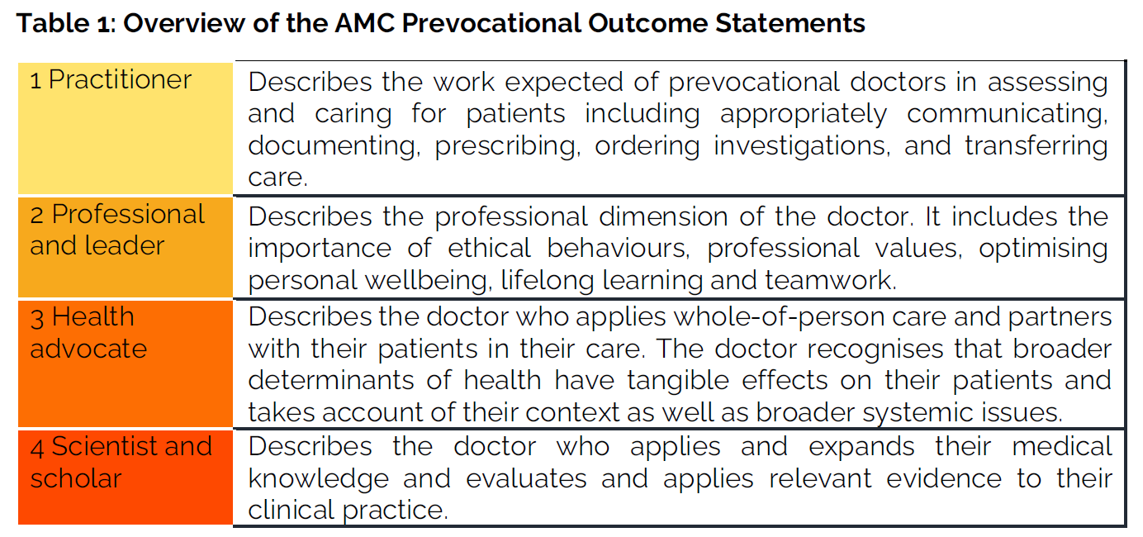
What should prevocational doctors learn?
Notes:
Prevocational doctors should receive practical, on the job or work-based training under supervision.
By the end of each year of prevocational training, prevocational doctors should be able to demonstrate the skills and knowledge outlined in the AMC Prevocational Outcome Statements.
These outcome statements are grouped in four domains as per Table 1.
The National Framework has been designed so that the day-to-day work of PGY1 or PGY2 doctors allows them to achieve the outcomes.

Slide 7
What should prevocational doctors learn?
Prevocational doctors take responsibility for achieving the prevocational outcomes – with supervisors support
The following are three key components that need to occur during every term:
Beginning of term discussion
Midterm assessment
End-of-term assessment
Notes:
Prevocational doctors are expected to take responsibility for driving the learning and assessment process and ensuring the outcome statements are met over the course of the year – with the supervisors support.
At the start of every term, there is a meeting between the prevocational doctor and their Term Supervisor to discuss the role and the prevocational doctor’s responsibilities in the team.
This is an important meeting to discuss the term description, the learning opportunities during the term and to develop a learning plan for the term.
Prevocational doctors will arrange a follow up discussion with a supervisor for a midterm assessment. Based on the feedback they receive; they may adjust their learning plan.
At the end-of-term discussion the Term Supervisor makes an assessment on the prevocational doctor’s performance during the term. The prevocational doctor will expect feedback on any areas that could be further developed and should take these suggestions forward into learning plans for subsequent terms.

Slide 8
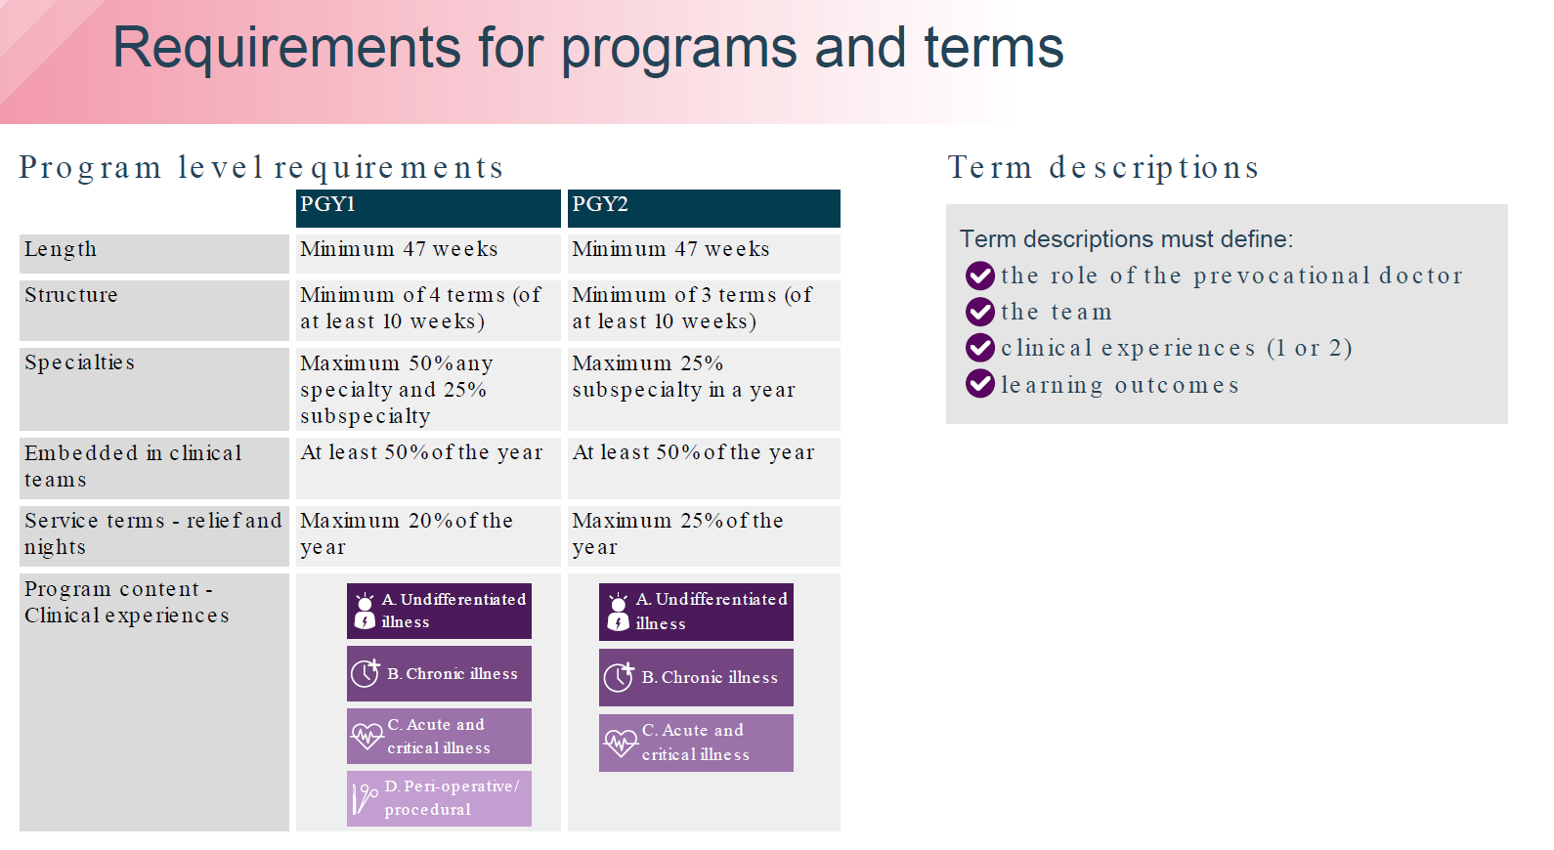
How is prevocational training structured?
Notes:
1. As with the current prevocational training programs the length of training will remain at a minimum of 47 weeks which excludes leave, such as annual leave
2. For interns, there is a minimum of 4 terms of at least 10 weeks, with current programs providing interns with 5 terms of 8 – 10 weeks. PGY2s will be required to complete a minimum of 3 terms of at least 10 weeks.
3. Interns can only complete a maximum of 50% of the year in any specialty and 25% in a subspecialty. PGY2s a maximum of 25% subspecialty in a year.
4. Interns and PGY2s will be embedded in clinical teams for at least 50% of the year.
5. Interns can only complete a maximum of 20% and PGY2s a maximum of 25% of the year in service terms e.g. relieving or nights terms.
6. LHNs are required to ensure that prevocational doctors are exposed to a breadth of clinical experiences in each year. Exposure to clinical care of patients in each of the following (1 or 2 per term):
Undifferentiated Illness patient care
Chronic Illness patient care
Acute and Critical Illness patient care
Peri-procedural patient care

Slide 9
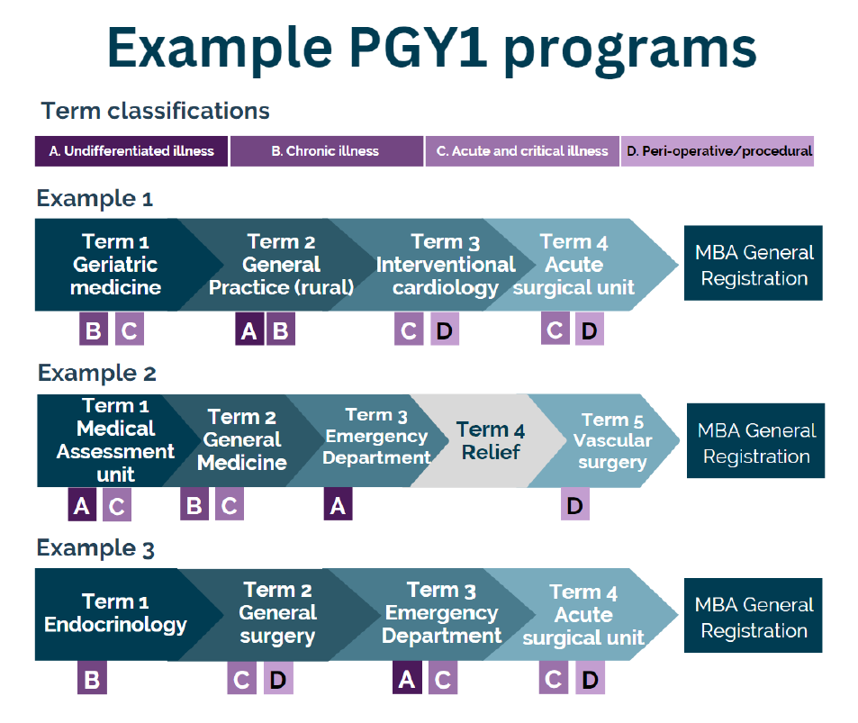
Notes:
Here are three examples of PGY1 Programs that result in general registration with the Medical Board of Australia

Slide 10
How will prevocational doctors learn?
Work-based clinical learning or learning on the job
Dedicated formal education program for the intern year
Access for PGY2 doctors to education programs to continue generalist experience.
Beginning of term discussion to include learning opportunities within term
EPA assessments are mapped to AMC outcome statements
Notes:
Prevocational training is centred on work-based clinical learning or learning on the job
AMC national standards require LHNs to provide educational programs for prevocational doctors, including a dedicated formal education program for the intern year and access for PGY2 doctors to education programs to continue broad generalist experience.
At the start of each term, there is a meeting with the Term Supervisor to outline the learning opportunities within the term
At the end of each year prevocational doctors should be able to demonstrate the skills and knowledge outlined in the AMC Prevocational Outcome Statements
End-of-term and entrustable professional activity (EPA) assessments (which will be discussed further in the next slide) are also mapped to the outcome statements.

Slide 11
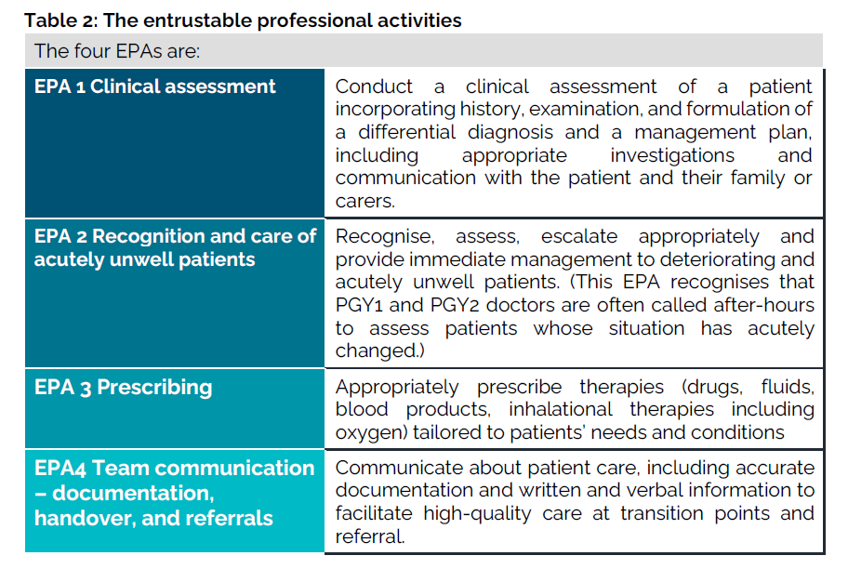
How will prevocational doctors learn? EPAs
Notes:
The National Framework includes four entrustable professional activities (EPAs) that describe essential components of the day-to-day work of PGY1 and PGY2 doctors.
Assessments of these EPAs measure the prevocational doctor’s level of entrustability - your judgement of how much supervision the doctor needs to safely perform the piece of work that has been observed.
EPAs are not mandatory until 2025, some LHNs have agreed to conduct EPA assessments using a paper version of the national EPA assessment form.
The four EPAs are Clinical Assessment, Recognition and care of the acutely unwell patient, Prescribing and Team Communication.

Slide 12
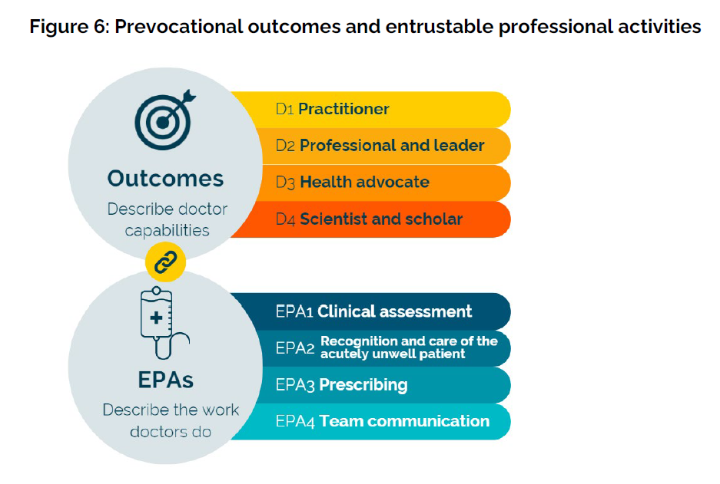
How will prevocational doctors learn? EPAs
Notes:
Prevocational doctors can cover many of the AMC Prevocational Outcome Statements through assessment of the EPAs, however additional activities will need to be undertaken for some of the outcome statements.
Outcome statements describe the broad and significant capabilities that prevocational doctors should achieve by the end of their PGY1 and PGY2 years. The outcome statements are:
Set within 4 domains – Practitioner, Professional and leader, Health advocate and Scientist and scholar.
To be achieved by the end of each prevocational year
Work-based, person-centred and take into account the prevocational doctor’s increasing responsibility for patient care under supervision.
Designed to be sufficiently generic to cover a range of learning environments.
The four EPAs are anchored to the prevocational outcome statements in the same domains and assist in achieving the outcome statements.

Slide 13
How will prevocational doctors learn?
Other on the job learning opportunities:
  Bedside or ward round teaching
  Team/unit based activities – meetings, audits, case presentations, seminars, journal clubs
  Teaching by other health professionals
  Simulation based teaching
  Online training modules
  Grand rounds
  Quality improvement activities
Notes:
Prevocational doctors are encouraged to take advantage of other on the job learning opportunities, which may include:
• Bedside or ward round teaching by supervisors, including registrars.
• Team or unit-based activities, including:
– radiology and pathology meetings
– multidisciplinary meetings
– mortality and morbidity audits
– case presentations and seminars
– journal clubs
• Teaching by other health professionals during patient clinical care
• Simulation-based training
• Online training modules
• Face to face or online teaching within vocational (specialty) training programs
• Grand rounds
• Quality improvement activities

Slide 14
How will prevocational doctors learn?
The E-Portfolio and record of learning
  Health ministers have agreed to the development of a national e-portfolio
  Implementation scheduled for 2025
  Web based and accessible via mobile devices
  All assessment documents will be accessible
  Automatically map progress against outcome statements
Notes:
Health Ministers have agreed to the development of a national e-portfolio to support prevocational training.
The e-portfolio will be web-based and accessible from desktop or mobile devices.
Implementation has delayed until 2025
When it becomes available, the e-portfolio will be used by prevocational doctors to access all framework documents, as well as their rotations, term descriptions and supervisors. The e-portfolio will automatically create a learning plan for each term, will be able to be adjusted, and will automatically map progress against the Prevocational Outcome Statements.
Supervisors will enter their feedback onto the e-portfolio and prevocational doctors will be able to enter self-reflections on their progress and learning needs.

Slide 15
How are prevocational doctors supervised?
There is normally more than one supervisor, each with different responsibilities:
A Term Supervisor – usually a consultant or head of unit. This person is responsible for term orientation and assessment and may also provide clinical supervision for some or all of the term.
An additional clinical supervisor:
  A consultant, senior medical practitioner or a registrar.
  This person in this role might change during the term and could also be the term supervisor.
  Provides informal feedback and contributes to assessments and can conduct the mid-term assessment.
  Should be at last PGY3 level.
Notes:
Prevocational doctors must be supervised at a level appropriate to their experience and responsibilities at all times.
In each term the supervision arrangements should be clear and explicit and be included in the term description.
Prevocational doctors should never be put in a position where they are asked to take on a level of responsibility beyond their scope of practice or perform procedures without an appropriate level of supervision.
In each term the supervision arrangements should be clear and explicit and be included in the term description.
There is usually more than one supervisor, each with different responsibilities:
A Term Supervisor – usually a consultant or head of unit. This person is responsible for term orientation and assessment and may also provide clinical supervision for some or all of the term.
An additional clinical supervisor:
A consultant, senior medical practitioner or a registrar.
This person in this role might change during the term and could also be the term supervisor.
Provides informal feedback and contributes to assessments and can conduct the mid-term assessment.
Should be at last PGY3 level.

Slide 16
How are prevocational doctors assessed?
Midterm assessment: Following the beginning of term discussion, prevocational doctors will arrange a mid-term assessment which can be completed by the Term Supervisor or an additional clinical supervisor, such as registrar or another consultant.
End-of-term assessment: This assessment must be completed by the Term Supervisor, who will also assess and provide feedback on whether the prevocational doctor has met the learning objectives identified at the beginning of the term.
Assessment Review Panel: At the end of each year the prevocational doctor’s performance will be reviewed by the LHNs Assessment Review Panel
Notes:
Work-based assessment is an important part of prevocational training to ensure PGY1 and PGY2 doctors acquire the skills and knowledge outlined in the AMC Prevocational Outcome Statements.
Beginning of term discussion: At the start of every term, there is a meeting between the TMO and their Term Supervisor to discuss the role and the learning objectives for the term.
Midterm assessment: Following the beginning of term discussion, prevocational doctors will arrange a mid-term discussion which can be completed by the Term Supervisor or an additional clinical supervisor, such as registrar or another consultant.
End-of-term assessment: This assessment must be completed by the Term Supervisor, who will also assess and provide feedback on whether the prevocational doctor has met the learning objectives identified at the beginning of the term or at an EPA or midterm assessment.
These assessments are based on achievement of the AMC Prevocational Outcome Statements. Prevocational doctors
At the end of each year the prevocational doctor’s performance will be reviewed by the LHNs Assessment Review Panel, based on end-of-term assessments, assessment of the EPAs and any additional learning activities that have been documented.

Slide 17
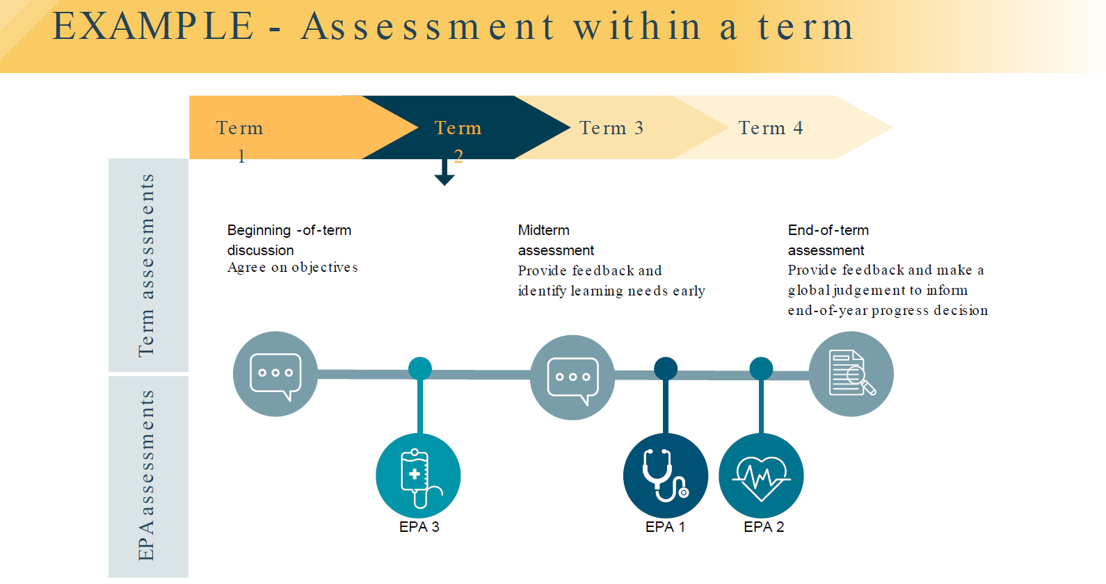
How are prevocational doctors assessed? Term Assessments
Notes:
An example of how assessments could occur in a term.

Slide 18
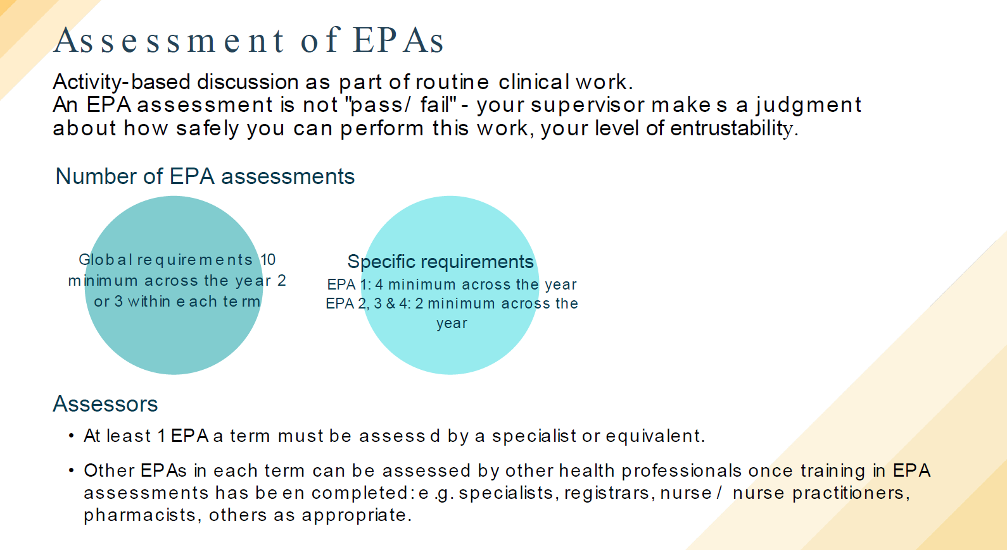
How will prevocational doctors learn? EPAs
Notes:
EPAs are expected to completed during the routine work of the prevocational doctor with supervisors making a judgement about how safely you can perform your work, and your level of entrusability.
The supervisor’s assessment is not a pass or fail. It is a judgement of the prevocational doctor’s degree of entrustability for the work being observed.
EPAs will be able to be assessed by specialists or equivalent and some will be able to be assessed by registrars, nurses, pharmacists and others as appropriate.
At least one EPA assessment per term should be completed by the term supervisor; others can be completed by other clinical supervisors, the registrar, other health professionals
EPA 1 will be assessed at least once in each term and EPAs 2-4 will be assessed at least twice throughout the year.
An EPA assessment should be able to be completed in 10 minutes or less
The number of EPA assessments is a minimum of 10 across each year with this achieved by completion of 2 or 3 each term.

Slide 19
Assessment of EPAs
The supervisor’s assessment is not ‘pass/fail.’
It is a judgement of the prevocational doctor’s degree of entrustability for the work being observed
The level of supervision required for the doctor to safely perform the specific clinical task you observed
  requires direct supervision
  requires proximal supervision
  requires minimal supervision
Notes:
The supervisor’s assessment is not a pass or fail. It is a judgement of the prevocational doctor’s degree of entrustability for the work being observed.
The level of supervision required for the doctor to safely perform the specific clinical task you observed. There are three levels of entrustability:
- requires direct supervision - the supervisor needs to directly observe the work.
- requires proximal supervision – the supervisor needs to be easily contacted and available to provide immediate and detailed review of the work.
- requires minimal supervision – the supervisor trusts the prevocational doctor to complete the task.

Slide 20
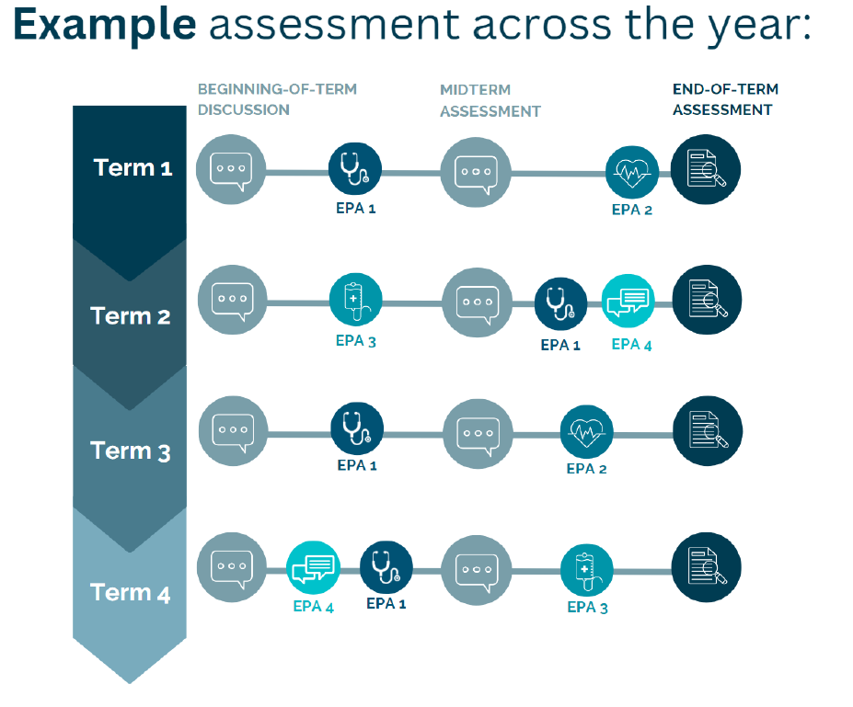
How will prevocational doctors be assessed?

Slide 21
Completion of prevocational training
PGY1 (internship):
Prevocational doctors apply to the Medical Board of Australia for general registration
LHN Assessment Review Panel determine if prevocational outcomes statements achieved:
  Assessment of outcomes of EPAs
  Mid-term and end-of-term assessments
  A minimum of 47 weeks of supervised practice
  Four terms in different specialities
  With required types of clinical exposure
No minimum number of end-of-term assessment that must be passed or EPAs at the level of “requires minimal supervision’
Notes:
At the end of the intern year, Prevocational doctors apply to the Medical Board of Australia for general registration
By considering the assessment outcomes from EPAs, end-of-term, and midterm assessments, the LHNs Assessment panel will decide whether the prevocational outcomes have been achieved at the end of the year.
Ensuring the prevocational doctor has undertaken 47 weeks of supervised practice in at least four accredited terms in different specialties with the required types of clinical exposure
There is no minimum number of end-of-term assessments that must be passed and no minimum number of EPA assessments at the level of ‘requires minimal supervision.’
The panel’s role is to make an assessment of whether the prevocational doctor has the skills and knowledge outlined in the outcome statements

Slide 22
Rights & Responsibilities of prevocational doctors & their supervisors
  Prevocational doctors have rights to an appropriate level of supervision
  Education program
  Safe workplace free from bullying, harassment and discrimination.
  As a supervisor, you can expect to be supported by your LHN
Notes:
Prevocational doctors have rights to an appropriate level of supervision, to an education program, and to a safe workplace free from bullying, harassment and discrimination.
As a supervisor, you can expect to be supported by your LHN through training in the framework.
The National Framework includes a requirement that all PGY1 and PGY2 term supervisors complete training in supervision,

Slide 23
What if a prevocational doctor needs additional support?
Important to maintain prevocational doctor wellbeing
TMOs have their own general practitioner
Ensure that your workload is not excessive
Ensure adequate supervision and support
Report wellbeing or bullying and harassment issues to your LHN
Doctors Health Program:
  Doctors’ Health SA
  Lifeline
  Beyond Blue
Notes:
Prevocational training can be physically, intellectually and emotionally challenging. It is important that you monitor and maintain TMO wellbeing and mental and physical health during PGY1 and PGY2, and as they progress further in their medical career.
It is recommended that TMOs have their own general practitioner which is critical to maintaining good health and wellbeing throughout their career.
Under the National Standards, LHNs have obligations to monitor and optimise TMO wellbeing, ensure that workload is not excessive and provide adequate supervision and support.
If you have concerns about TMOs personal wellbeing or have witnessed or experienced bullying, harassment or discrimination, it is very important that you seek help. There will be a number of individuals in your LHN who have the experience and authority to provide this help, including your Director of Clinical Training (DCT), your Medical Education Officer (MEO) or your Executive Director of Medical Services (EDMS).
You can also contact Doctors Health Programs. Access telephone support at any time of the day from the Doctors’ Health SA confidential GP support for SA doctors and Medical Students, and can also access support from services such as Lifeline or Beyond Blue.

Slide 24
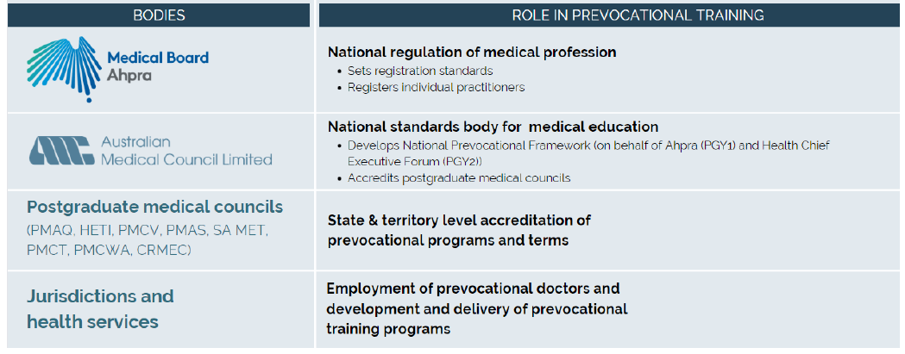
How is the quality of prevocational training programs assured?
Notes:
Individual LHNs develop and deliver prevocational training programs, and both the programs and the individual terms within them must be accredited.
Accreditation is a process of external peer review of a training program against the AMC National Standards and Requirements for Prevocational (PGY1 and PGY2) Training Programs and Terms.
The SA MET Health Advisory Council Accreditation Committee appoints accreditation teams, which include prevocational doctors or registrars, to accredit prevocational training programs and terms against the criteria described in the national standards.
These criteria outline minimum standards, including for program structure, governance, content and delivery, clinical experience, supervision and support, feedback and assessment.
SA MET in turn is accredited by the AMC, which also accredits medical schools and specialist colleges.
Based on the accreditation team’s report, the AMC makes recommendations to the Medical Board of Australia, which then approves SA MET to accredit your training program.

Slide 25
QUESTIONS?

Slide 26
Thank you for joining us
today!

